Slide 1
Ensemble Learning
Trang M. Nguyen (MSc), UET-VNUH, QAI
June 29, 2021

Slide 2
Outline
Model Generalization
Underfitting, Overfitting, Good Fit
Bias Variance Trade-off
Ways to Deal with Underfitting & Overfitting
Ensemble Learning Overview
Bagging
Bagging and Pasting
Out-of-Bag Evaluation
The Problem of Bagging
Boosting
AdaBoost
Gradient Boosting
XGBoost
Stacking
Exercises

Slide 3
Model Generalization

Slide 4
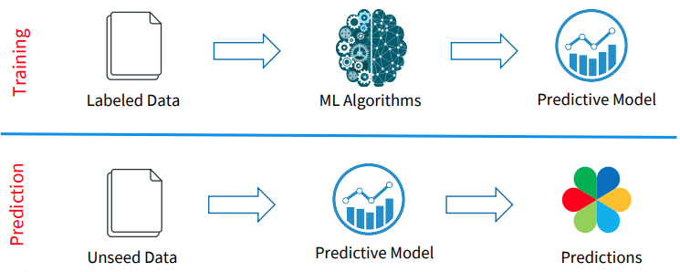
Two Phases of Model Development

Slide 5
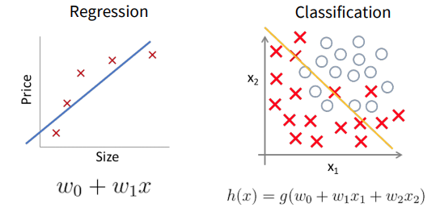
Underfitting
Underfitting: A model that fails to sufficiently learn the problem and performs poorly on a training dataset and does not perform well on holdout/validation samples.

Slide 6
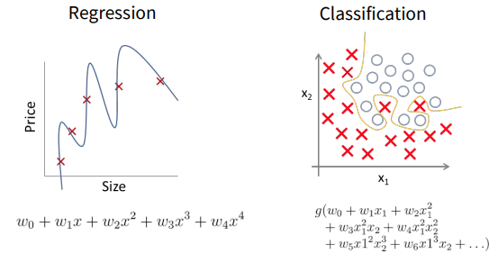
Overfitting
Overfitting: A model that learns the training dataset too well, performing well on the training dataset but does not perform well on holdout samples.

Slide 7
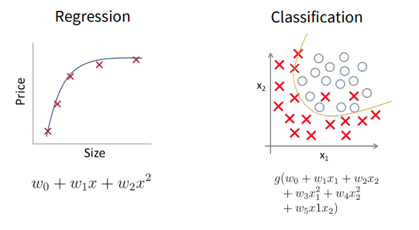
Good Fit
Good Fit: A model that suitably learns the training dataset and generalizes well to the holdout dataset.

Slide 8
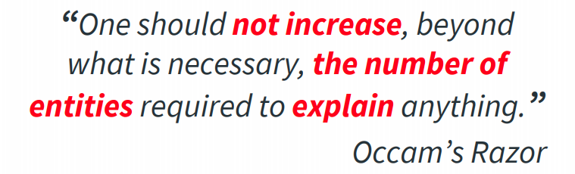
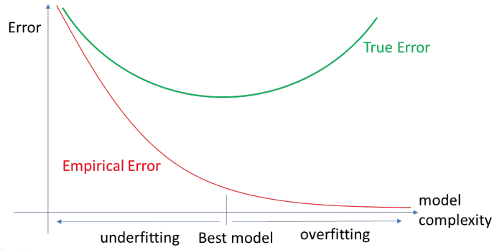
The Problem of Model Generalization

Slide 9
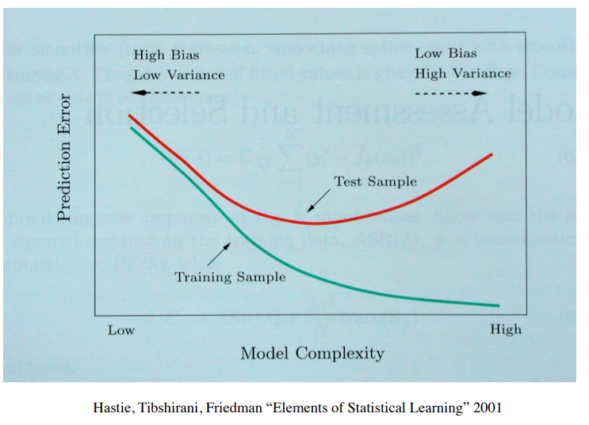
Bias Variance Trade-off

Slide 10
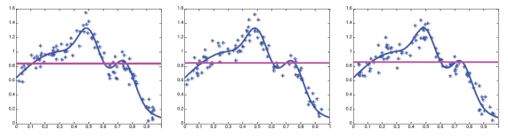
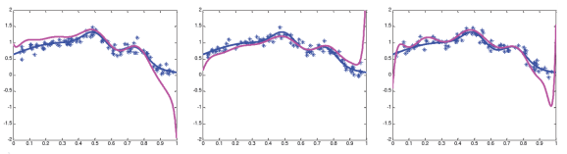
Bias Variance Trade-off
High bias, Low variance – poor approximation but robust/stable
Low bias, high variance – good approximation but unstable

Slide 11
Ways to Deal with Underfitting & Overfitting
Underfitting | Overfitting
High empirical errors on both training and holdout sets Model is too simple High bias Maybe not converged yet | Low empirical error on train but high empirical error on the holdout set Model is too complex High variance May pass the ‘gold’ converged point

Slide 12
Ways to Deal with Underfitting & Overfitting
Underfitting | Overfitting
Increase the complexity of the model by adding more features Increase the number of the training epochs Remove noise from data Try more complex models | Increase the training data size Reduce the model complexity by feature selections Ensemble Learning Regularization, Early stopping, etc.

Slide 13
Ensemble Learning Overview

Slide 14
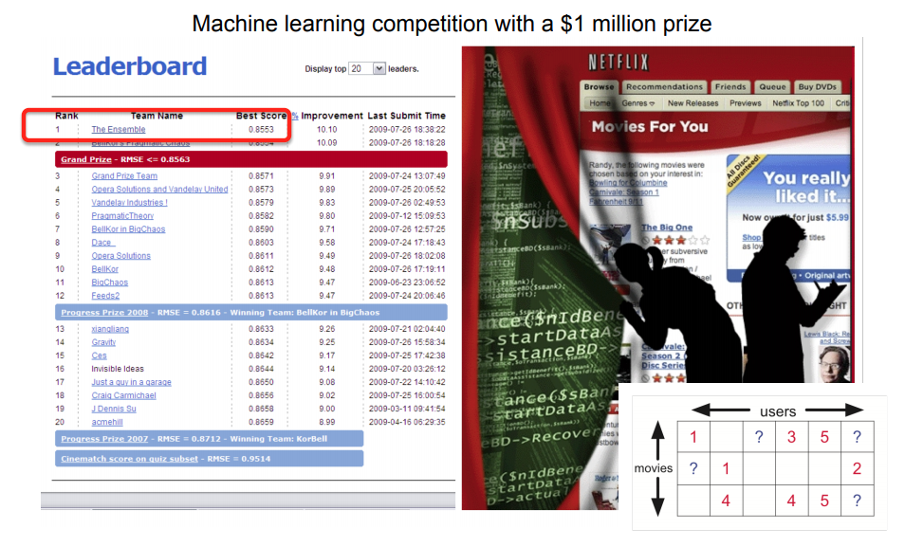
Applications
Netflix Prize - Supervised learning task:
Training data is a set of users and ratings (1-5) those users have given to movies
Construct a classifier that given a user and an unrated movie, correctly classify that movie as either 1-5 stars

Slide 15
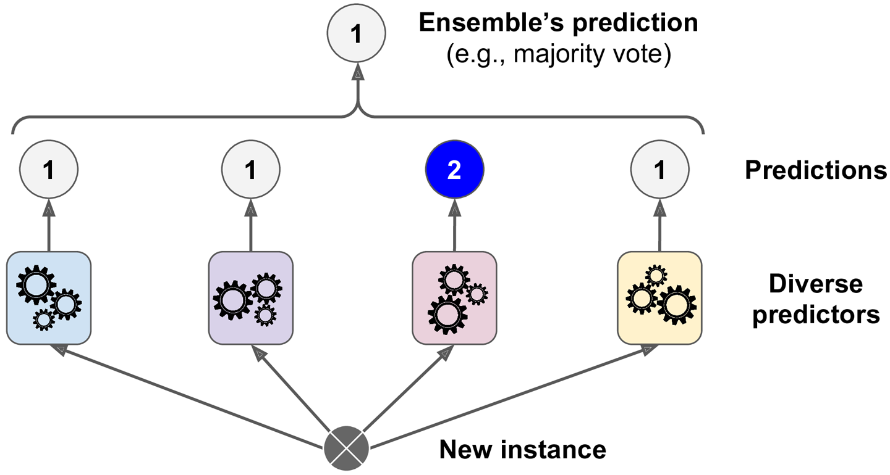
Ensemble Learning
Wisdom of the crowd: ask a complex question to thousands of random people, then aggregate their answers. In many cases you will find that this aggregated answer is better than individual’s answer (sometimes even experts’ answer) Ex: How many jellybeans in the jar? Individual estimates VS. group average?
General Idea: aggregate the predictions of a group of predictors will often get better predictions than with the best individual predictor.
A group of predictors is called an ensemble; thus, this technique is called Ensemble Learning
Ensemble Learning algorithm is called an Ensemble method
Intuition: simulate what we do when we combine an expert panel in a human decision-making process

Slide 16
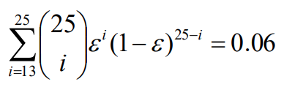
Why does it work?
Suppose there are 25 base classifiers
Each classifier has error rate, ɛ = 0.35
Assume classifiers are independent
Probability that the ensemble classifier makes a wrong prediction (i.e., at least 13 out of the 25 classifiers misclassified):

Slide 17
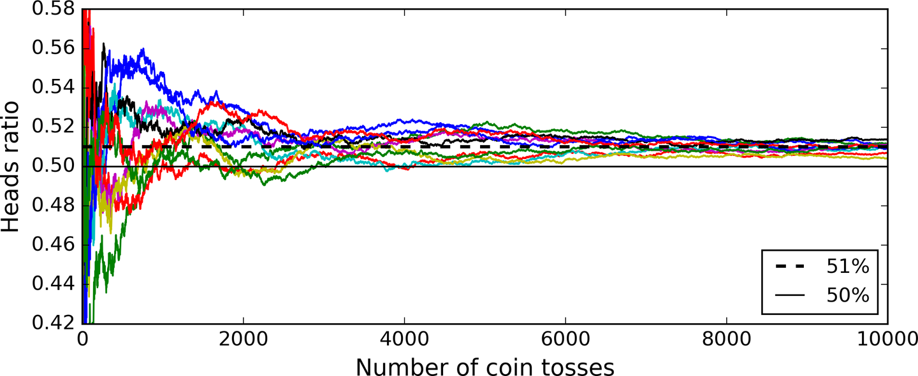
Why does it work?
The law off large number:
Suppose you have a slightly biased coin that has a 51% chance of coming up heads, and 49% chance of coming up tails. If you toss it 1,000 times, you will generally get more or less 510 heads and 490 tails.
The probability of obtaining a majority of heads after 1,000 tosses is close to 75%, with 10,000 tosses, the probability climbs over 97%
Be careful: this is only true if all classifiers are perfectly independent, making uncorrelated errors, which is clearly not the case since they are trained on the same data. They are likely to make the same types of errors. ➔ Ensemble methods work best when the predictors are as independent from one another as possible.

Slide 18
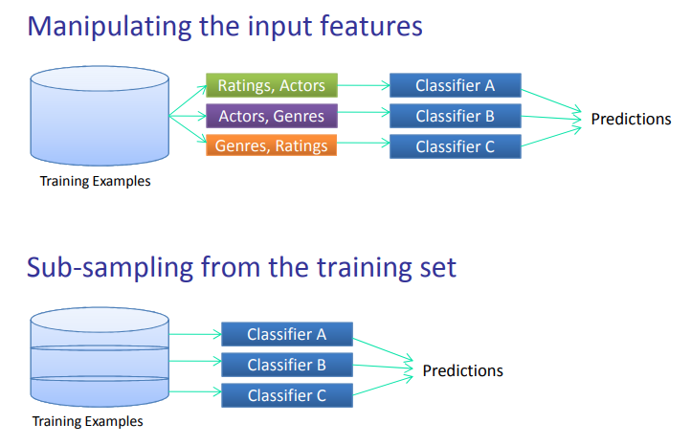
Data manipulation
Sampling both training instances and features is called the Random Patches method
Keeping all training instances but sampling features is called the Random Subspaces method

Slide 19
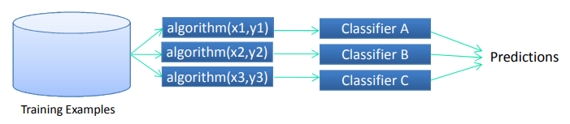

Modeling process manipulation
Manipulating the parameter sets
Manipulating the algorithms

Slide 20
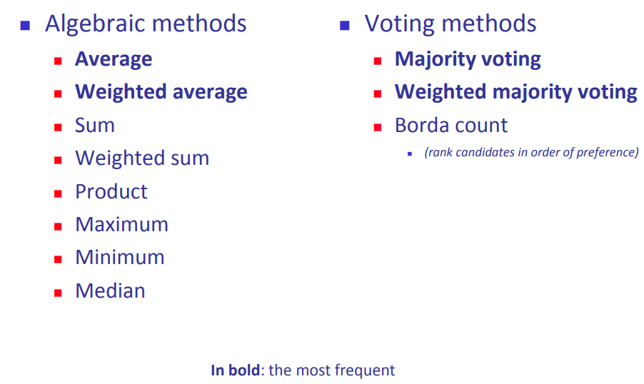
How to combine models (the integration phase)

Slide 21
Bagging

Slide 22
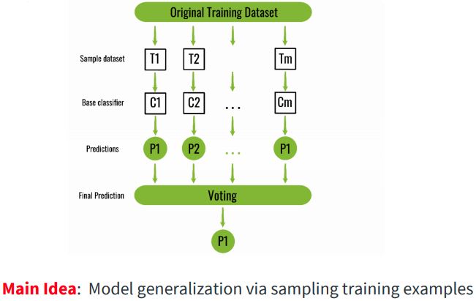
Bagging and Pasting
When sampling is performed with replacement, this method is called bagging (Bootstrap aggregating)
When sampling is performed without replacement, it is called pasting
Both bagging and pasting allow training instances to be sampled several times across multiple predictors, but only bagging allows training instances to be sampled several times for the same predictor
Bagging is generally preferred because Bootstrapping introduces a bit more diversity in the subsets ➔ predictors end up being less correlated, so the ensemble’s variance is reduced

Slide 23
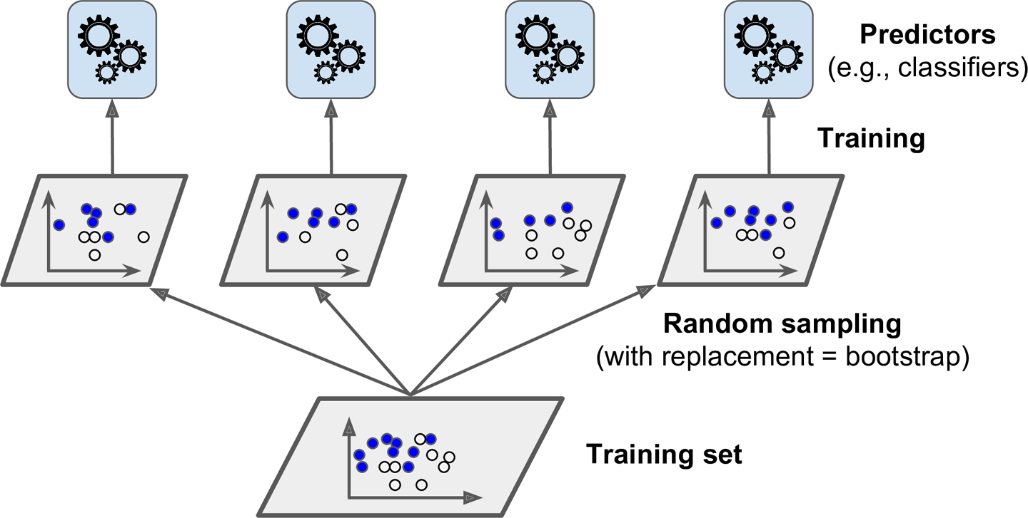
Bagging and Pasting
Once all predictors are trained, the ensemble can make a prediction for a new instance by simply aggregating the predictions of all predictors
Each individual predictor has a higher bias than if it were trained on the original training set, but aggregation reduces both bias and variance
Generally, the net result is that the ensemble has a similar bias but a lower variance than a single predictor trained on the original training set

Slide 24
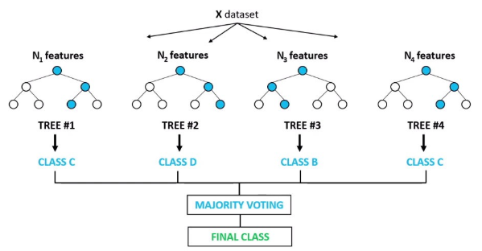
Random Forest
The Random Forest algorithm introduces extra randomness when growing trees
Instead of searching for the very best feature when splitting a node (like Decision Tree), it searches for the best feature among a random subset of features

Slide 25
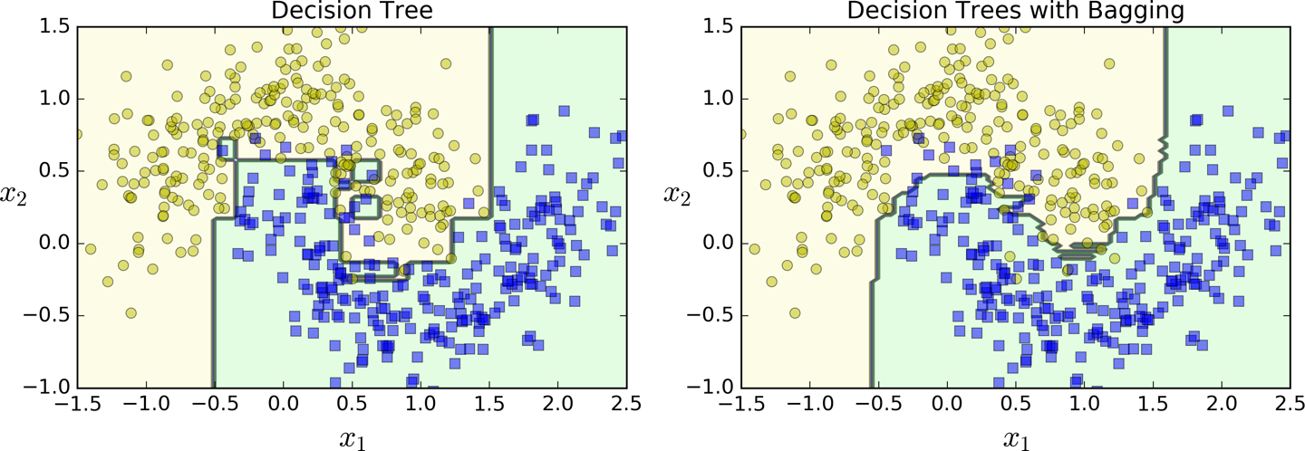
Example
Comparison of the decision boundary of a single Decision Tree with the decision boundary of a bagging ensemble of 500 trees.
➔ The ensemble’s predictions will likely generalize much better than the single Decision Tree’s predictions: the ensemble has a comparable bias but a smaller variance (i.e., it makes roughly the same number of errors on the training set, but the decision boundary is less irregular)

Slide 26
Bagging - Summary
Accuracy
Often significantly better than a single classifier derived from the same training dataset
For noisy data: not considerably worse, more robust because it does not focus any particular instance
Proved improved accuracy in prediction because it reduces the variance
Requirement: Need unstable classifier types (to compliment each other)
Unstable means a small change to the training data may lead to major decision changes
Examples of “unstable” learners that have high variance: decision trees, neural networks, nearest-neighbours.
Scalability:
Predictors can all be trained in parallel, via different CPU cores or even different servers.
Similarly, predictions can be made in parallel.

Slide 27
Out-of-Bag Evaluation
With bagging, some instances may be sampled several times for any given predictor, while others may not be sampled at all
Each sample has probability (1 – 1/n) of being remained ➔ Consider the whole training dataset, it has probability (1 – 1/n)^n of being remained. This value approach 1/e ~ 0.37 for large n
Meaning that means that only about 63% of the training instances are sampled on average for each predictor. 37% of the training instances that are not sampled are called out-of-bag (OOB) instances
A predictor never sees the OOB instances during training, it can be evaluated on these instances, without the need for a separate validation set or cross-validation
Evaluate the ensemble itself by averaging out the OOB evaluations of each predictor:
Iterate through each observation (instance)
Determine the learners which didn’t had this observation within their subset
Perform the prediction for this observation using the learners identified above
Average out the prediction error for each observation

Slide 28
The Problem of Bagging
Inefficient sampling:
Every example has equal chance to be sampled
No distinction between “easy” examples and “difficult” examples
Better sampling strategy: Focus on the examples that are difficult to classify
Inefficient model combination
A constant weight for each classifier
No distinction between accurate classifiers and inaccurate classifiers
➔ Better combination strategy: Accurate model should be assigned larger weights

Slide 29
Boosting

Slide 30
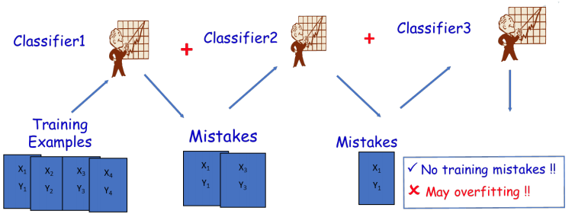
Boosting
Boosting (originally called hypothesis boosting) refers to any Ensemble method that can combine several weak learners into a strong learner.
General Idea: train predictors sequentially, each trying to correct its predecessor

Slide 31
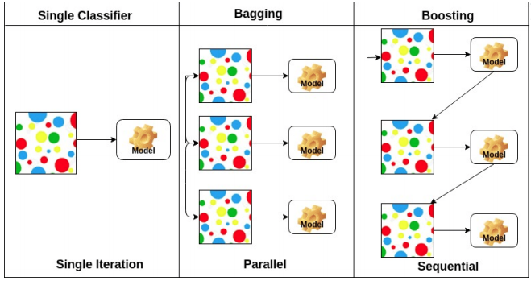
Bagging VS. Boosting
Differences with Bagging:
Models are built sequentially on modified versions of the data
The predictions of the models are combined through a weighted sum/vote
Boosting tends to achieve greater accuracy, but it also risks overfitting the model to misclassified data
Sequential learning technique cannot be parallelized (or only partially), since each predictor can only be trained after the previous predictor has been trained and evaluated. ➔ it does not scale as well as bagging

Slide 32
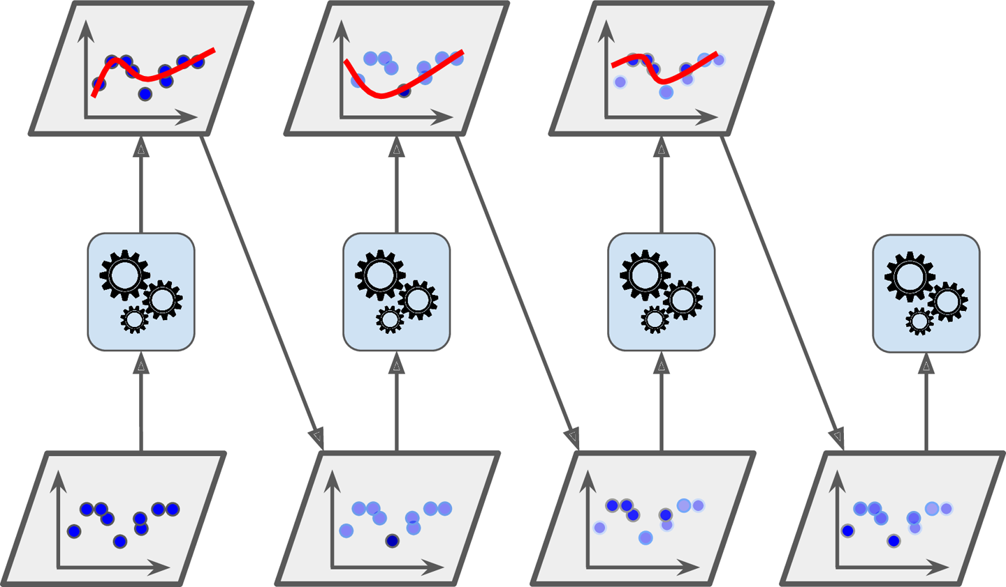
AdaBoost
Analogy: Consult several doctors, based on a combination of weighted diagnoses - weight assigned based on the previous diagnosis accuracy
First train the base classifier on all the training data with equal importance weights on each case.
Then re-weight the training data to emphasize the hard cases and train a second model
Keep training new models on re-weighted data
Finally, use a weighted committee of all the models for the test data
➔ Sequential learning technique has some similarities with Gradient Descent, except that instead of tweaking a single predictor’s parameters to minimize a cost function, AdaBoost adds predictors to the ensemble, gradually making it better.
AdaBoost sequential training with instance weight updates

Slide 33
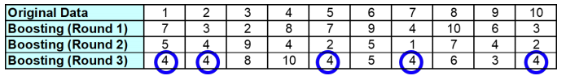
AdaBoost Example
Instances that are wrongly classified will have their weights increased
Instances that are correctly classified will have their weights decreased
Example 4 is hard to classify
Its weight is increased; hence it is more likely to be chosen again in subsequent rounds

Slide 34
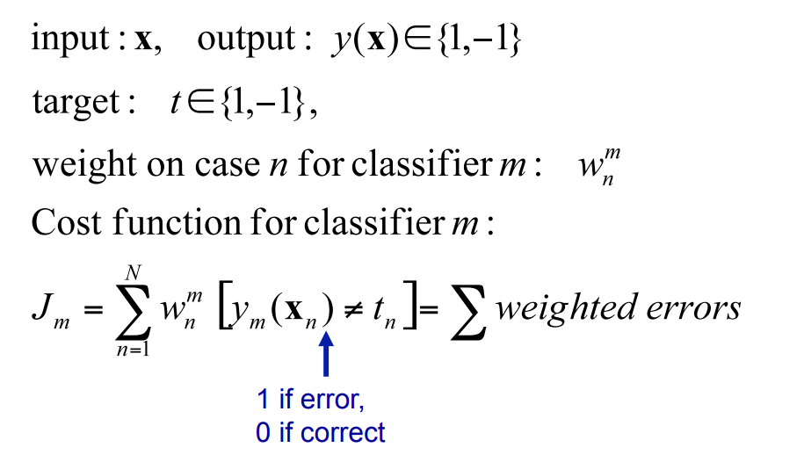
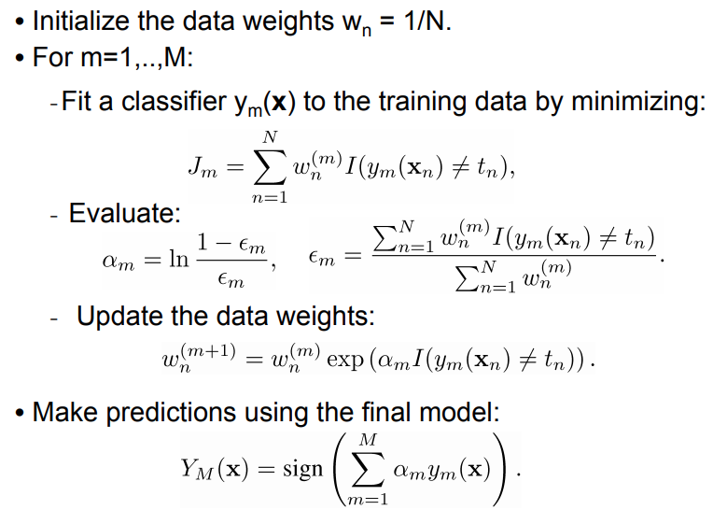
AdaBoost Algorithm

Slide 35
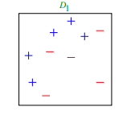
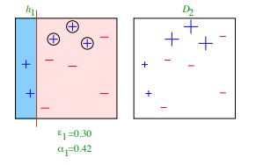
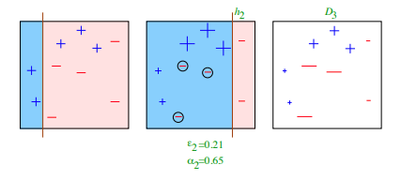
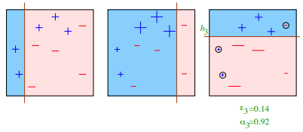
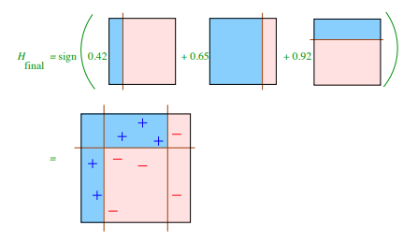
AdaBoost Example
weak classifiers = vertical or horizontal half-planes
Round 1
Round 2
Round 3
Final Classifier Final Classifier

Slide 36
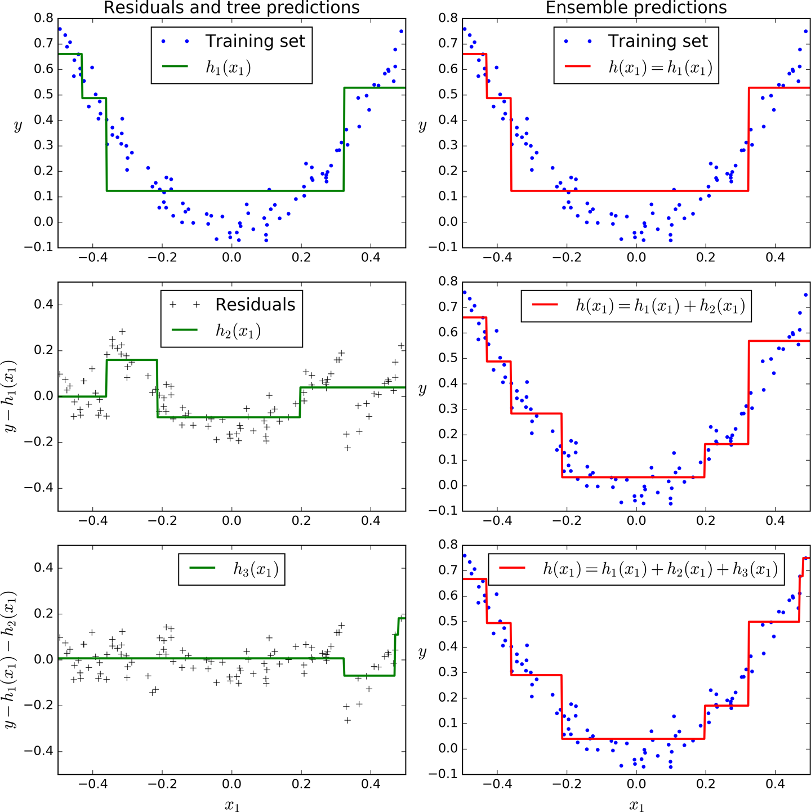
Gradient Boosting
Instead of tweaking the instance weights at every iteration like AdaBoost does, this method tries to fit the new predictor to the residual errors made by the previous predictor.
Example: regression task using Decision Trees as the base predictors
Gradient Boosting has three main components:
Loss Function: estimate how good the model is.
Weak Learner: classifies our data but does so poorly, perhaps no better than random guessing
Additive Model: This is the iterative and sequential approach of adding the weak learners one step at a time

Slide 37
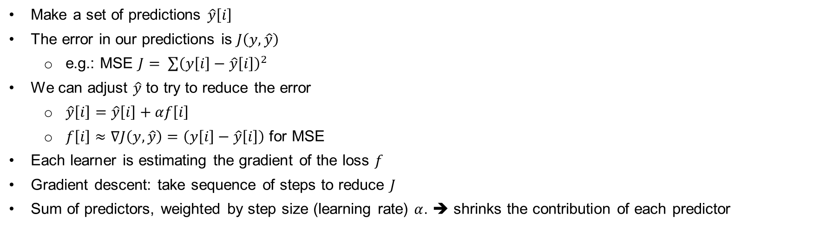
Gradient Boosting Example
Make a set of predictions $\hat{y}\left[i\right]$
The error in our predictions is $J\left(y, \hat{y}\right)$
e.g.: MSE $J= \sum{{\left(y\left[i\right]−\hat{y}\left[i\right]\right)}^{2}}$
We can adjust $\hat{y}$ to try to reduce the error
$\hat{y}\left[i\right]=\hat{y}\left[i\right]+αf\left[i\right]$
$f\left[i\right]≈∇J\left(y, \hat{y}\right)=\left(y\left[i\right]−\hat{y}\left[i\right]\right)$ for MSE
Each learner is estimating the gradient of the loss $f$
Gradient descent: take sequence of steps to reduce $J$
Sum of predictors, weighted by step size (learning rate) $α$. ➔ shrinks the contribution of each predictor

Slide 38
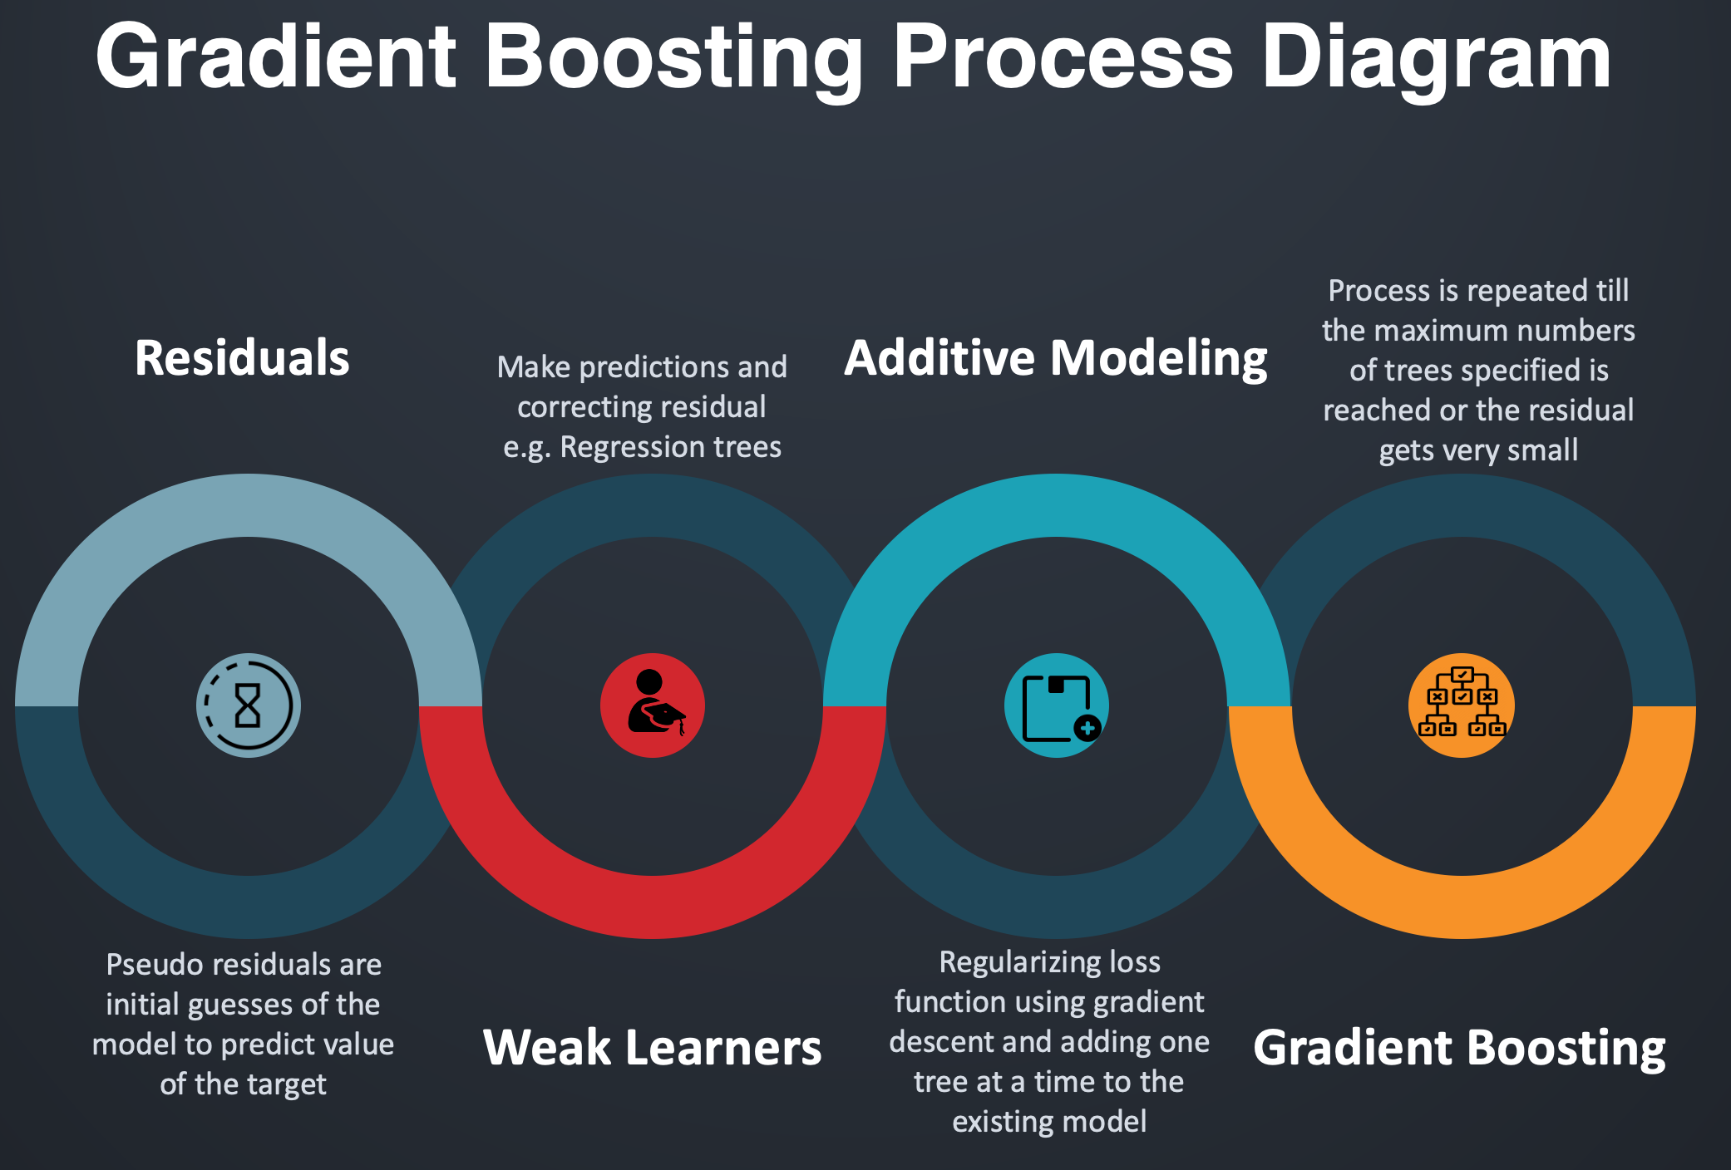
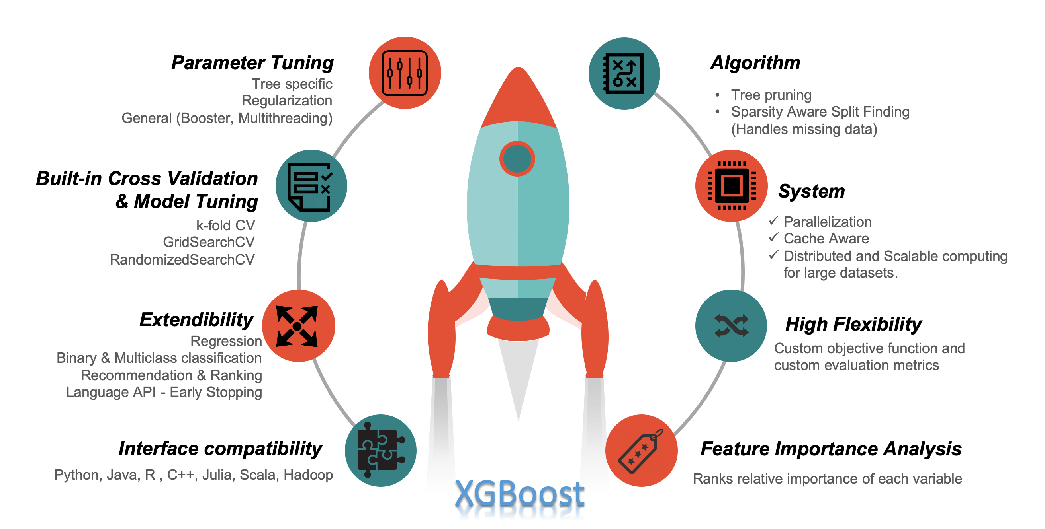
XGBoost
XGBoost as gradient boosting on “steroids” - a perfect combination of software and hardware optimization techniques to yield superior results using less computing resources in the shortest amount of time.
Gradient Boosting Process Diagram
XGBoost features

Slide 39
AdaBoost VS. Gradient Boosting
Both AdaBoost and Gradient Boost learn sequentially from a weak set of learners. A strong learner is obtained from the additive model of these weak learners. The main focus here is to learn from the shortcomings at each step in the iteration.
AdaBoost increases the weights of the wrongly predicted instances and decreases the ones of the correctly predicted instances.
The weak learner thus focuses more on the difficult instances.
After being trained, the weak learner is added to the strong one according to its performance.
Gradient boosting doesn’t modify the sample distribution.
Instead of training on a newly sampled distribution, the weak learner trains on the remaining errors of the strong learner.
At each iteration, the pseudo-residuals are computed, and a weak learner is fitted to these pseudo-residuals
➔ AdaBoost is more about voting weights and gradient boosting is more about adding gradient optimization.

Slide 40
Gradient Boosting – Pros and Cons
Pros:
Often provides predictive accuracy that cannot be trumped
Lots of flexibility - can optimize on different loss functions and provides several hyper parameter tuning options that make the function fit very flexible.
Cons:
Gradient Boosting Models will continue improving to minimize all errors. This can overemphasize outliers and cause overfitting.
Computationally expensive - often require many weak learners which can be time and memory exhaustive.
The high flexibility results in many parameters that interact and influence heavily the behavior of the approach.

Slide 41
Stacking

Slide 42
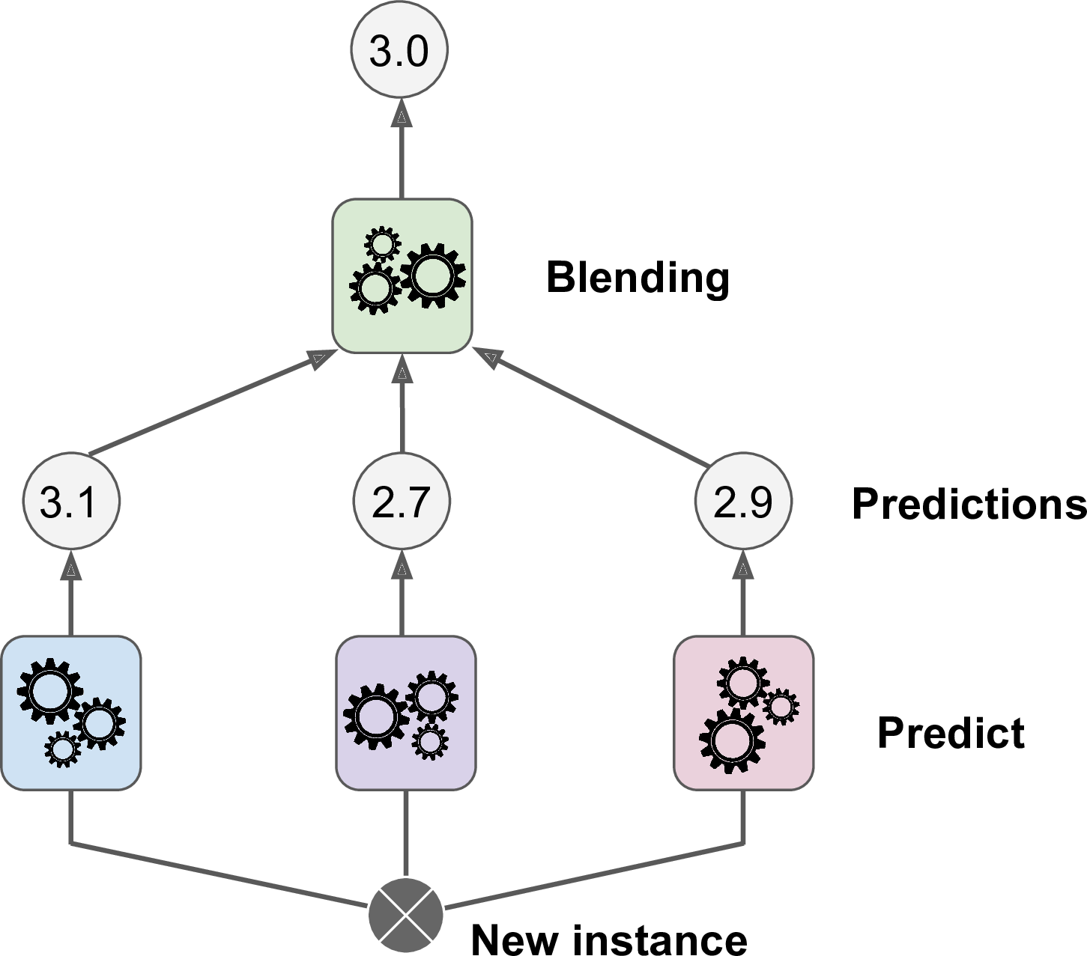
Stacking
Idea: instead of using trivial functions (such as hard voting) to aggregate the predictions of all predictors in an ensemble ➔ Train a model to perform this aggregation
Base learners predicts a different value
Blender (or meta-learner) takes these predictions as inputs and makes the final prediction
Training by leave-one-out cross-validation: Blender inputs = Predictions on left-out examples
Aggregating predictions using a blending predictor

Slide 43
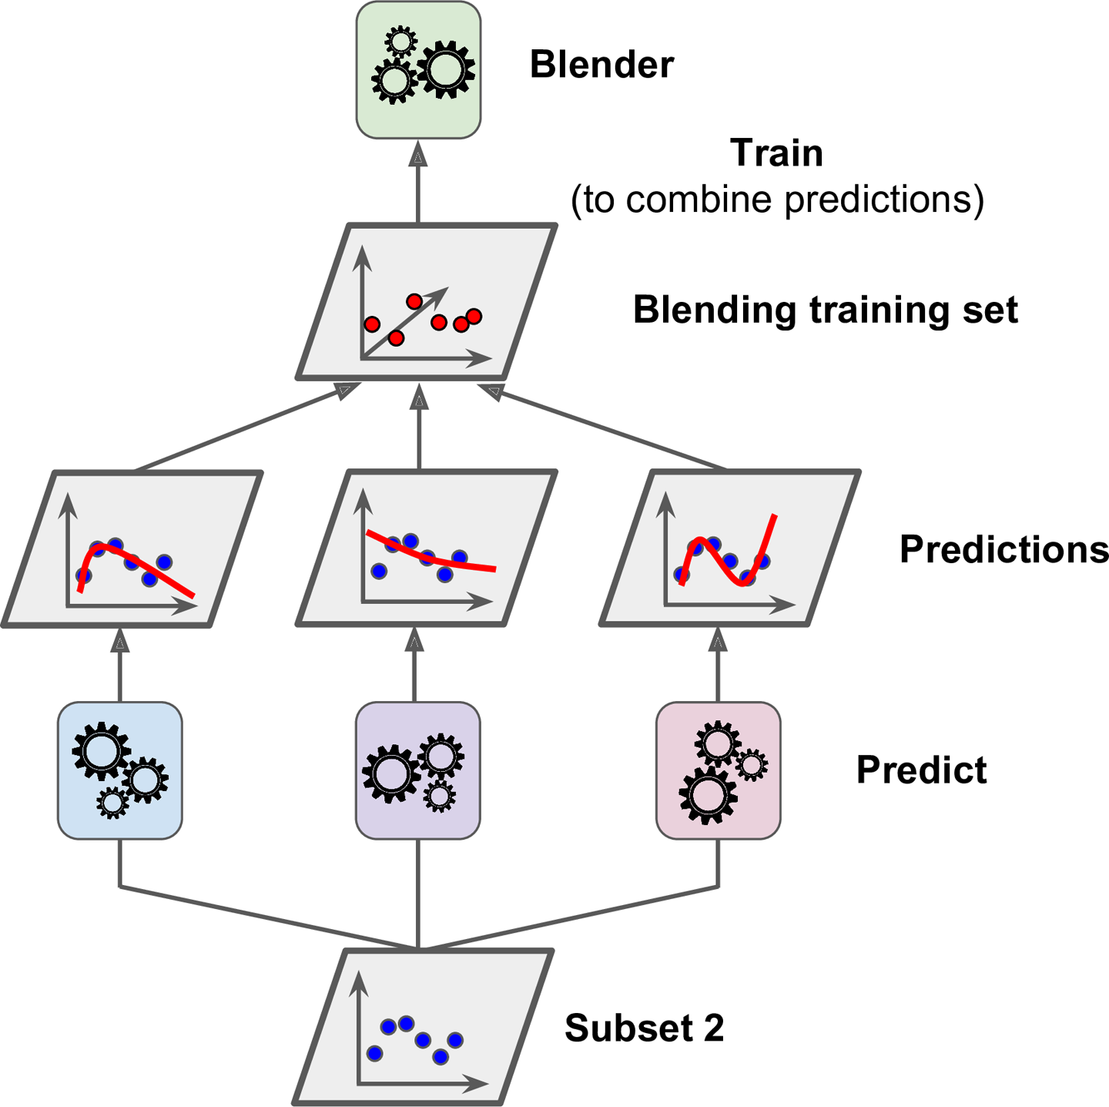
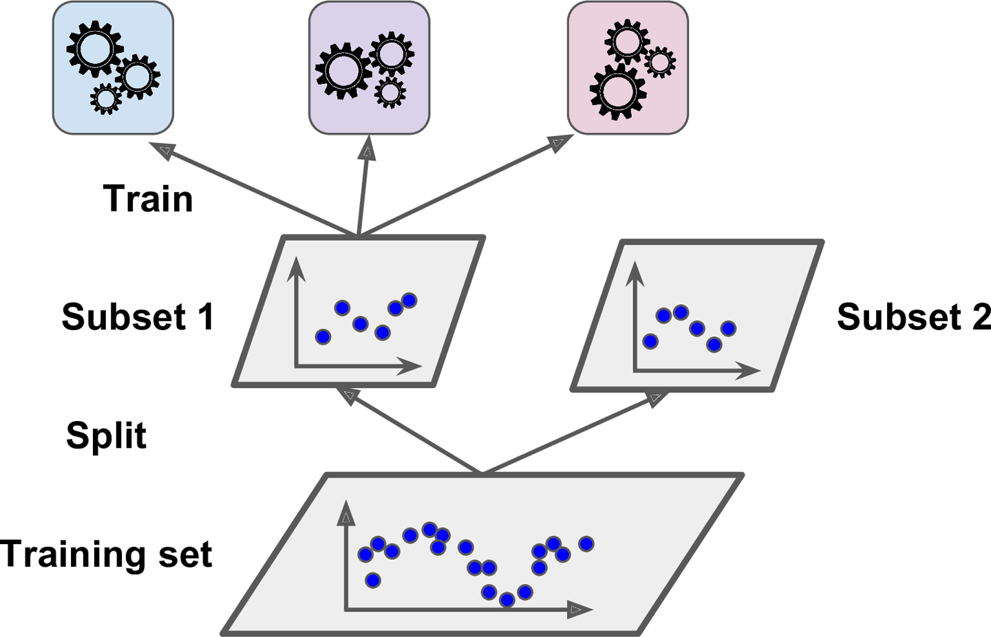
Stacking
Training the first layer
Training the blender

Slide 44
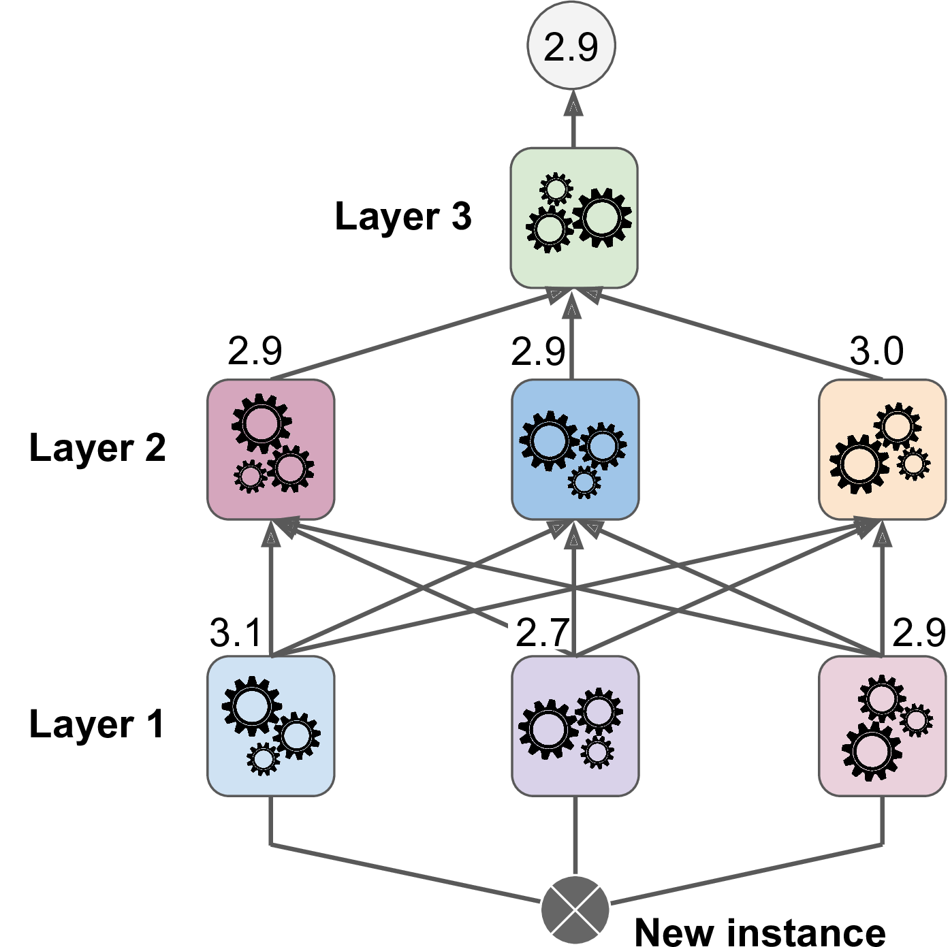
Stacking
Split the training set into three subsets:
Set 1: train the 1st layer
Set 2: create the training set used to train the 2nd layer (using predictions made by the predictors of the 1st layer)
Set 3: create the training set to train the 3rd layer (using predictions made by the predictors of the 2nd layer)
Predictions in a multilayer stacking ensemble

Slide 45
Exercises

Slide 46
Exercises
Quiz:
If you have trained five different models on the exact same training data, and they all achieve 95% precision, is there any chance that you can combine these models to get better results? If so, how? If not, why?
What is the difference between hard and soft voting classifiers?
Is it possible to speed up training of a bagging ensemble by distributing it across multiple servers? What about pasting ensembles, boosting ensembles, random forests, or stacking ensembles?
What is the benefit of out-of-bag evaluation?
If your AdaBoost ensemble underfits the training data, what hyperparameters should you tweak and how?
If your Gradient Boosting ensemble overfits the training set, should you increase or decrease the learning rate?
Programming:
Input: MNIST dataset
Requirement:
Build and run individual classifiers to make predictions on the validation set and create a new training set with the resulting predictions: each training instance is a vector containing the set of predictions from all your classifiers for an image, and the target is the image’s class.
Evaluate the ensemble on the test set. For each image in the test set, make predictions with all your classifiers, then feed the predictions to the blender to get the ensemble’s predictions.
How does it compare to the best individual classifier?

Slide 47
Thank You!

